Slide 1
Identity, the Self, and Personal Expression
Jordyn Carton

Slide 2
Day 1 - Agenda
History of clay and ceramics
Overview of Response Assignment
Work on first ceramic artist Response Assignment
  Due: Day 3

Slide 3
History of Clay
Clay is a sedimentary rock consisting mainly of tiny mineral particles
One of the oldest art materials used
  Pottery shards found from over 16,000 years ago
Also historically and currently used as a construction material
  Bricks, tiles

Slide 4
History of Clay
People of prehistoric times would carry water in woven baskets lined with clay
  They figured out that clay would retain its shape when dried and could be hardened in hot ash to become sturdier (early firing)
From ~400 B.C.E., earthenware pottery was mass produced using a potter’s wheel in many parts of the world

Slide 5
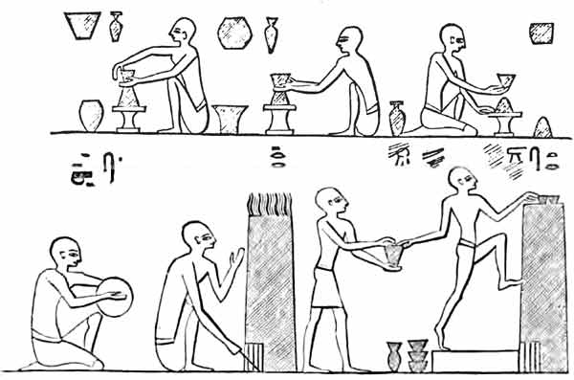
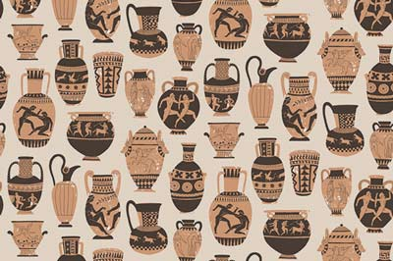
History of Ceramics
Why would pottery being non-porous be important?
Ancient Egyptians made kilns to fire their pottery
They later discovered an early version of glaze through experimentation
  Made the pottery non-porous after firing
Ancient Greeks made intricate designs that would tell stories

Slide 6
Who has used clay before?
Notes:
What have those experiences been like for you?

Slide 7
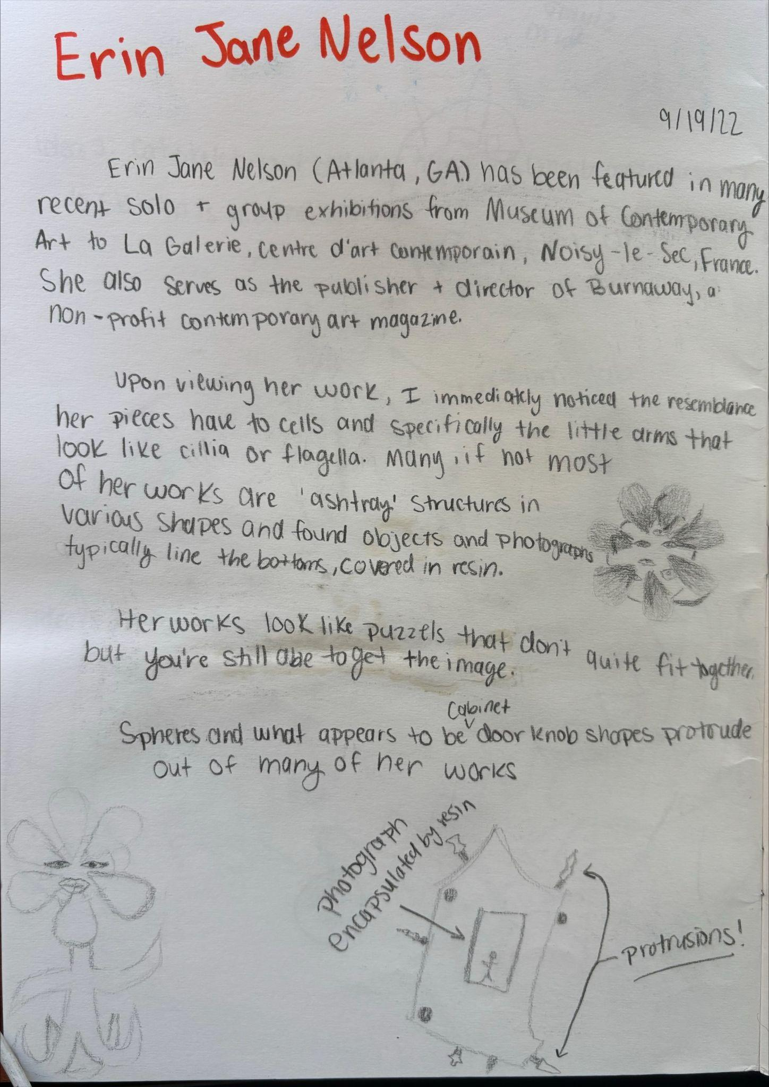
Response Assignments
DUE: Day 3
Choose an artist from the Artist List
  Explore their website and Google them
Write ~100 words in response to their ceramic works
  How does it make you feel? What do you like or dislike? What parts inspire you and your own work?
Include drawings

Slide 8
Artist List
Erin Jane Nelson
Claudia V. Solórzano
Nicki Green
Candice Lin
Morgan Rose Free
Sharif Farrag
Jessica Jackson Hutchins
Woody De Othello
Salvador Jiménez-Flores
Anders Herwald Ruhwald
Tammie Rubin
Wade Tullier
Kathy Butterly
Jane Margarette

Slide 9
Day 2 - Agenda
Intro to Coil Building
Coiling + slip and score demo
Practice coil building
Start making coil pots

Slide 10
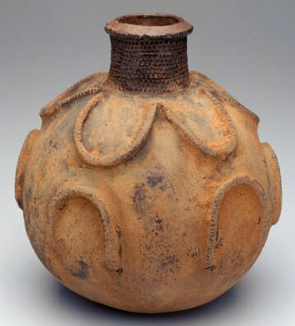
Coil Building
Developed across many cultures and continents independently
Believed to have originated over 10,000 years ago!
  Allowed for larger, more variable-shaped vessels than pinch pots
  Used for cooking, storing food, carrying water, and ceremonial purposes
Notes:
What purpose could this vessel have served?

Slide 11
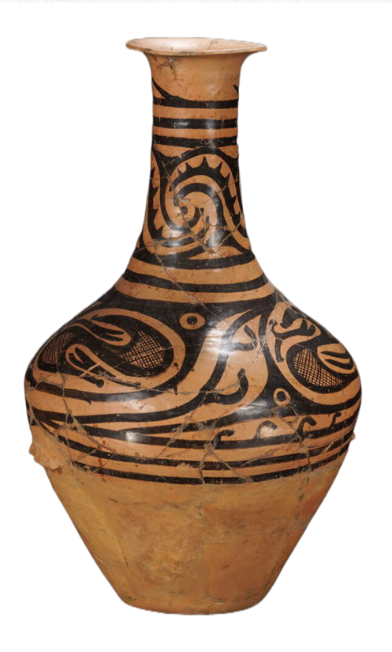
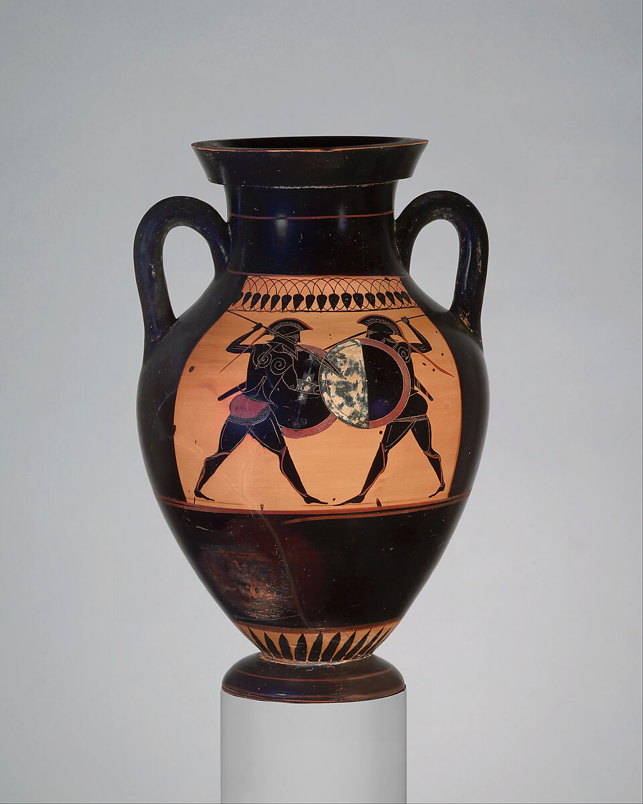
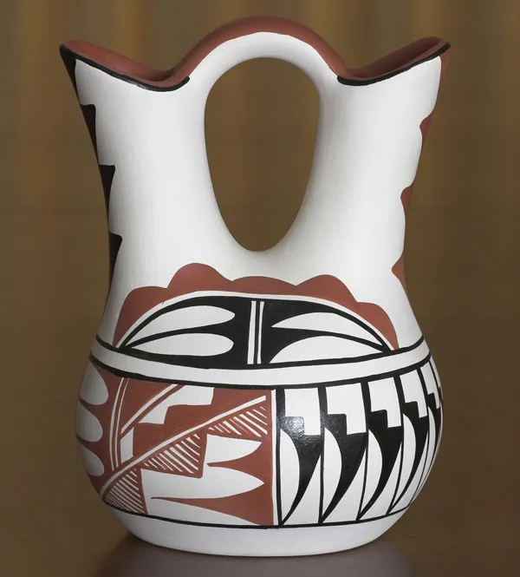
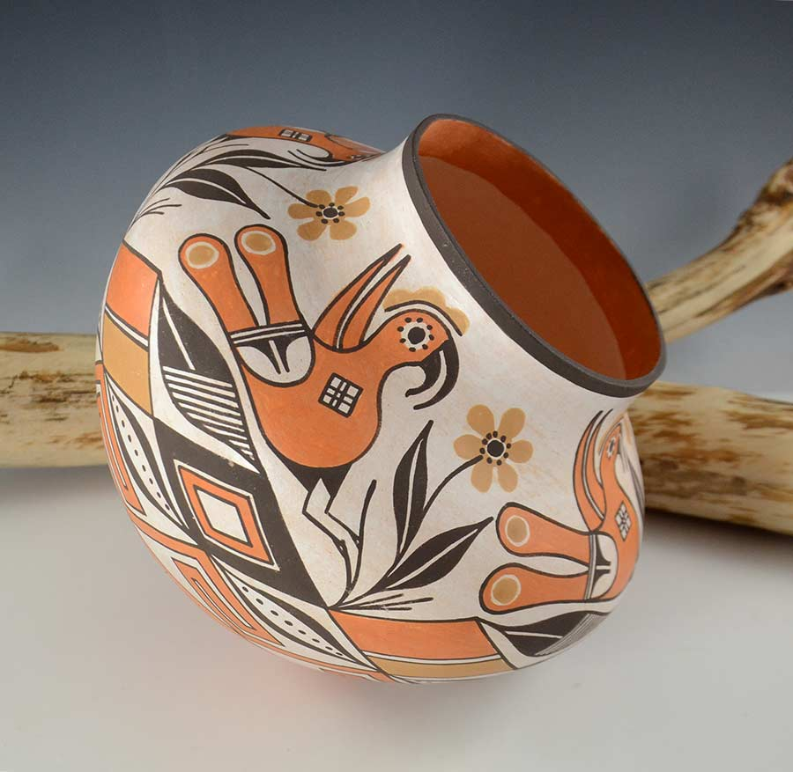
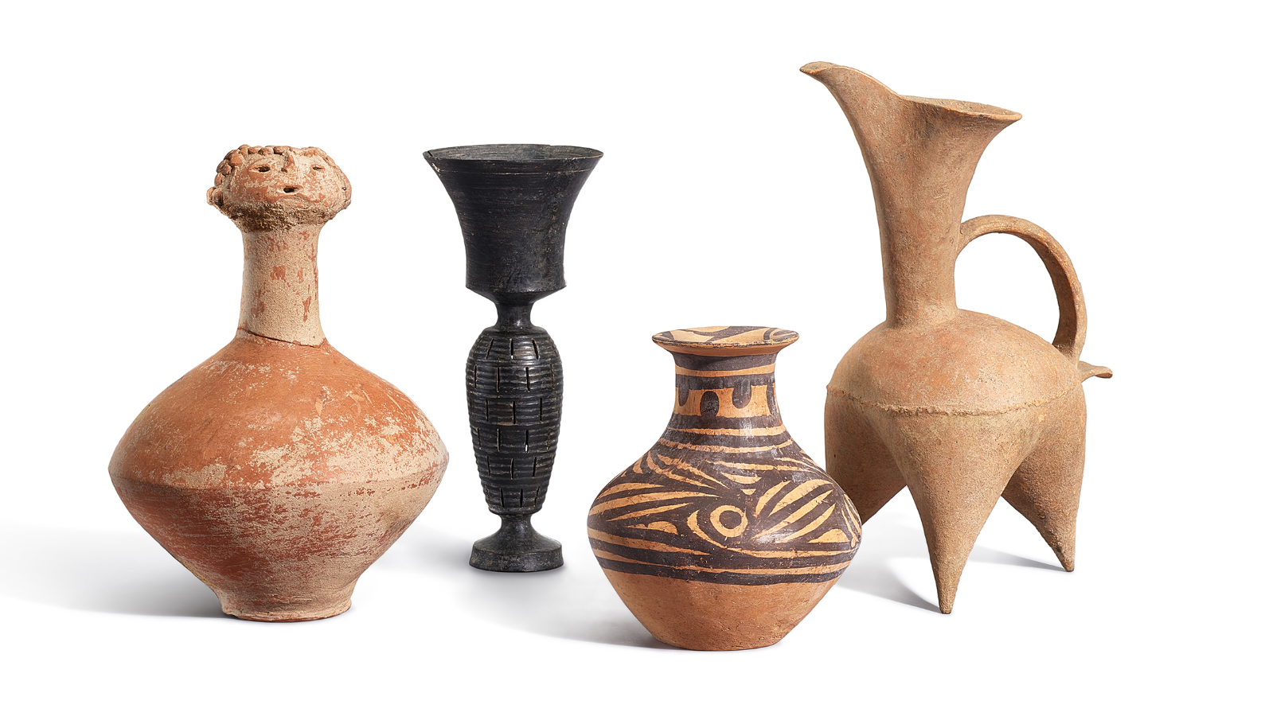
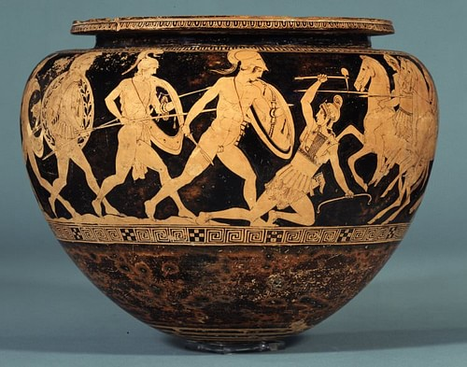
Coil Building
Ancient Greeks
Neolithic Chinese
Puebloans

Slide 12
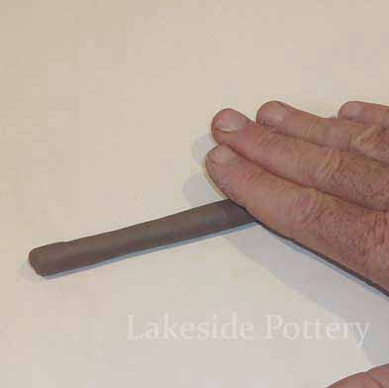
How to Coil
Break off even pieces of clay balls
Roll the pieces into long cylinders with an even thickness
  Just like Play-Doh!
Begin wrapping a coil in a circle, building on top
of itself
  Slip and score to make the attachment
secure
Notes:
What purpose could this vessel have served?

Slide 13
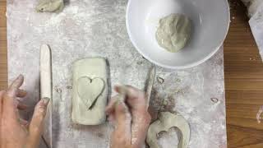

Slide 14
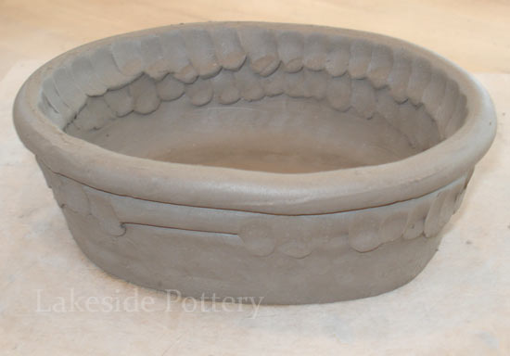
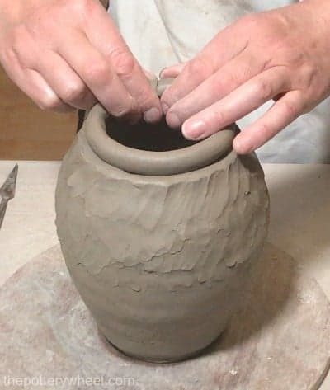
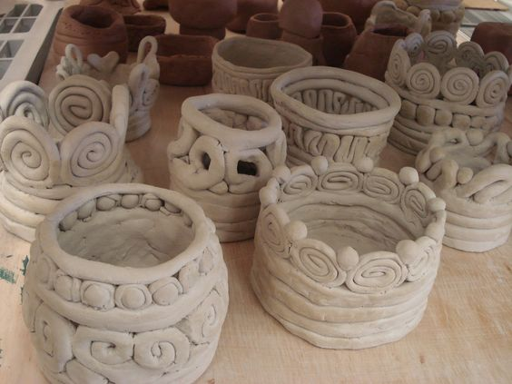
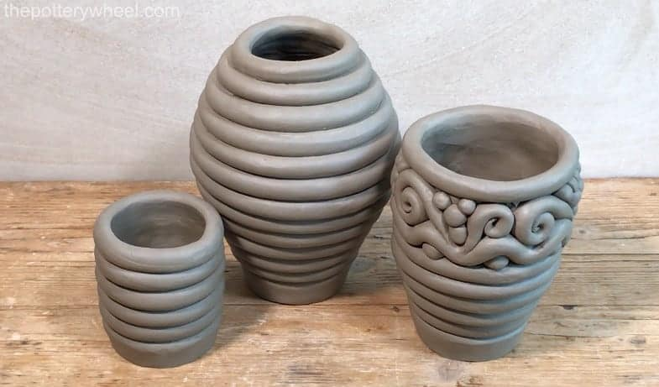
Coil Pots
Make 2 coil pots
  1 should have the coils showing
  1 should have the coils blended/smoothed
Notes:
What purpose could this vessel have served?

Slide 15
Day 3 - Agenda
Demo smoothing coils
Finish 2 coil pots
  1 with visible coils, 1 with smoothed coils
Intro Project #1 - Personality Pots
  Symbols and personality traits
2-3 project sketches; Due: Day 4

Slide 16
Coil Pots
Make 2 coil pots
  1 should have the coils showing
  1 should have the coils blended/smoothed
If you need help smoothing: Lakeside Pottery
Notes:
What purpose could this vessel have served?

Slide 17
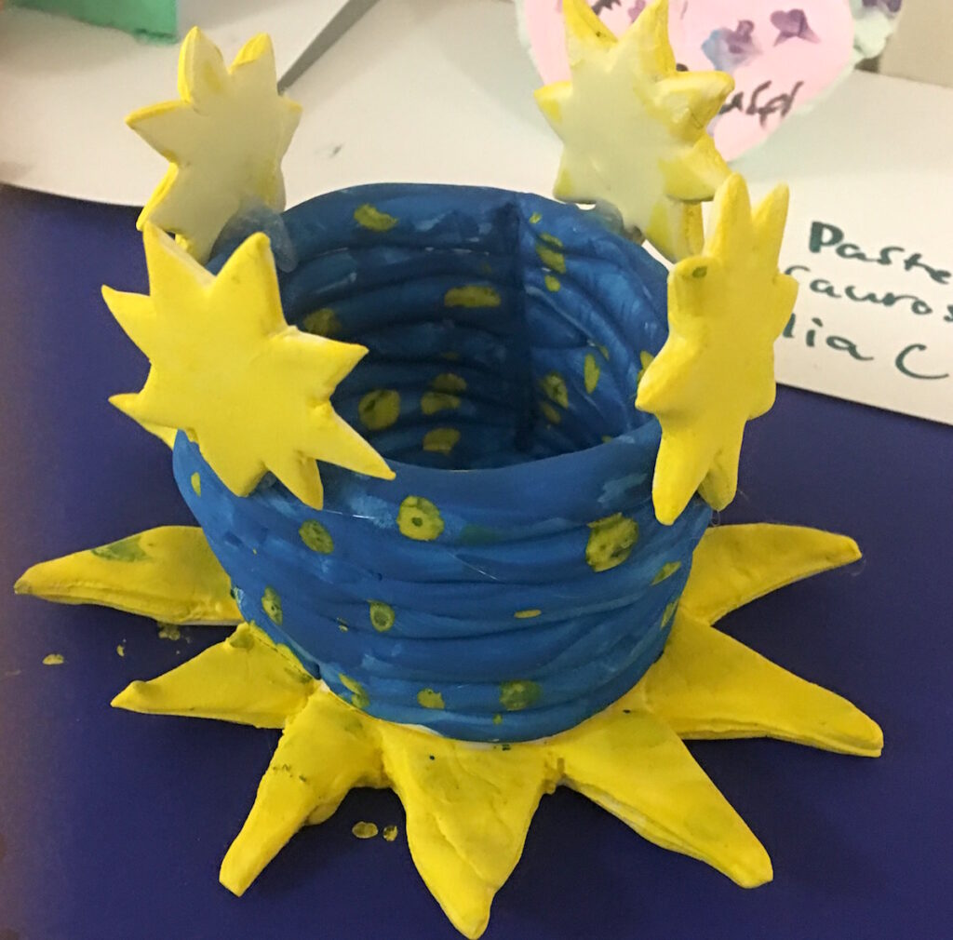
Personality Pots
Coil pot
  Blended or unblended
  Must have a 3D symbol that represents a part of your personality
Symbol
  A mark, sign, or emblem that represents an idea, object, or trait
Notes:
What purpose could this vessel have served?

Slide 18
What are some personality traits?
How could we represent them?
Notes:
What have those experiences been like for you?

Slide 19
Assignment
2-3 rough sketches for project #1
  2 sentences per sketch that explains the connection to your personality
DUE: Day 4 (Next Class)

Slide 20
Day 4 - Agenda
Check sketches with me
Underglaze test coil pots
  Optional, but you may want to use this as an opportunity to test some colors you may want to use on your final project
Start Personality Pots project

Slide 21
Personality Pots
Coil pot
  Blended or unblended
  Must have a 3D symbol that represents a part of your personality
Notes:
What purpose could this vessel have served?

Slide 22
Day 5 - Agenda
Personality Pots work day
  Get started, if you haven’t yet
  Work on the coil pot base today

Slide 23
Day 6 - Agenda
Personality Pots work day
  Continue to work on the coil pot base
  Get started on 3D symbols that you will attach to the base

Slide 24
Day 7 - Agenda
Personality Pots work day
  Attach symbols to pots
  Completely finish pots today (need time to dry)
If you finish early, you can glaze your test coil pots

Slide 25
Day 8 - Agenda
Personality Pots work day
  Begin underglazing Personality Pots (optional)
Finish glazing test pots
If extra time, explore a virtual museum
  American Museum of Ceramic Art
  Arizona State Museum

Slide 26
Day 9 - Agenda
Review glaze results of test pots
  Receive personality pots back after bisque firing
Glaze your personality pot
If you have extra time, start on Response Assignment #2
  No repeats!
  Due: Day 11

Slide 27
Response Assignments
DUE: Day 11
Choose an artist from the Artist List
  Explore their website and Google them
Write ~100 words in response to their ceramic works
  How does it make you feel? What do you like or dislike? What parts inspire you and your own work?
Include drawings

Slide 28
Artist List
Erin Jane Nelson
Claudia V. Solórzano
Nicki Green
Candice Lin
Morgan Rose Free
Sharif Farrag
Jessica Jackson Hutchins
Woody De Othello
Salvador Jiménez-Flores
Anders Herwald Ruhwald
Tammie Rubin
Wade Tullier
Kathy Butterly
Jane Margarette

Slide 29
Day 10 - Agenda
Get your Personality Pots back
Partner up for TAG critique

Slide 30
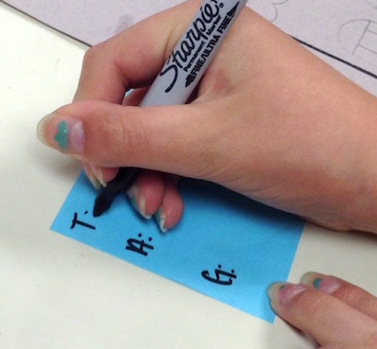
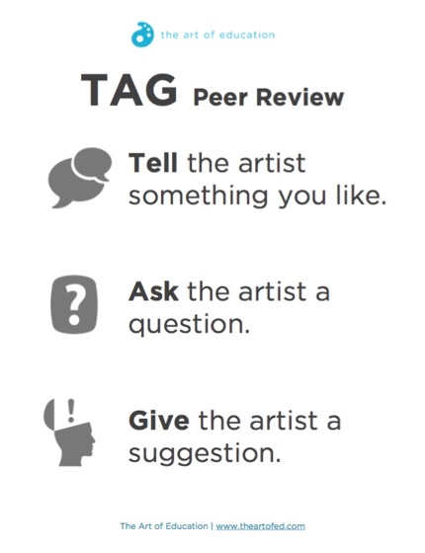
TAG Critique
Find a partner
Grab a sticky note and label it T: A: G:
  Write something you like, ask a question, give a suggestion
Continue until you’ve critiqued all of your peers

Slide 31
Day 11 - Agenda
Introduction to Slab Building
Intro Project #2 - Slab Mugs
Response Assignment #3
  Due: Day 12
Bring empty, rinsed cans to next class

Slide 32
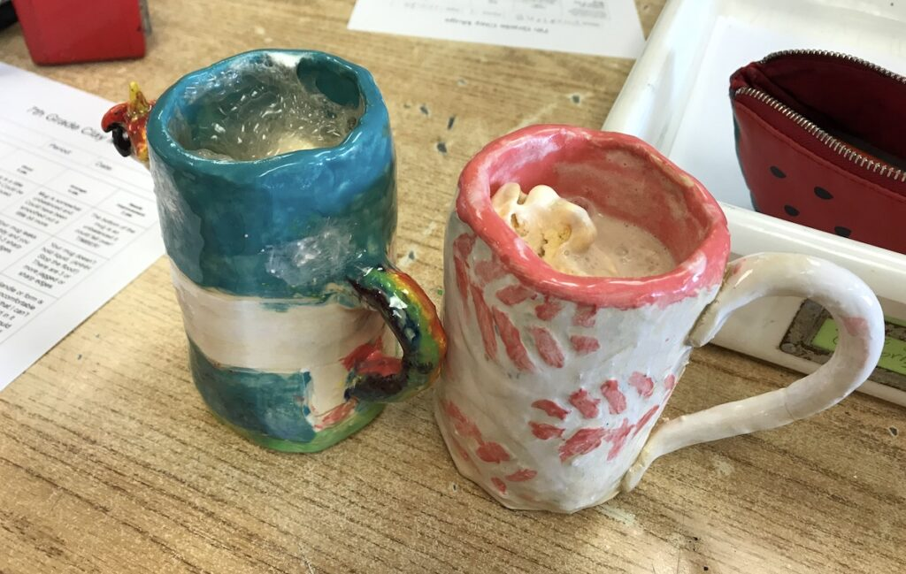
Slab Mugs
2 mugs made from slabs
  1st mug is a ‘gift to yourself,’ the design should reflect your own aesthetic interests
  2nd mug is for someone else, choose your design based on designs and colors you think they may enjoy
  Can have a handle, but it is not required
Notes:
What purpose could this vessel have served?

Slide 33
Response Assignments
DUE: Day 12 (Next Class)
Choose an artist from the Artist List
  Explore their website and Google them
Write ~100 words in response to their ceramic works
  How does it make you feel? What do you like or dislike? What parts inspire you and your own work?
Include drawings

Slide 34
Artist List
Erin Jane Nelson
Claudia V. Solórzano
Nicki Green
Candice Lin
Morgan Rose Free
Sharif Farrag
Jessica Jackson Hutchins
Woody De Othello
Salvador Jiménez-Flores
Anders Herwald Ruhwald
Tammie Rubin
Wade Tullier
Kathy Butterly
Jane Margarette

Slide 35
Remember to bring in an empty, rinsed can!
Notes:
What have those experiences been like for you?

Slide 36
Day 12 - Agenda
Slab demo
Roll and cut your first slab
2-3 thumbnail sketches for project #2
  Include 2 sentences of reasoning per sketch

Slide 37
How to Make a Slab
With a rolling pin, roll out clay into a slab
  Try to maintain an even thickness throughout the whole slab
Wrap a piece of construction paper around the can and cut it to size
The size of your construction paper will reflect the size of your mug
Cut your slab using your paper template
Notes:
What purpose could this vessel have served?

Slide 38
Assignment
2-3 rough sketches for project #2
  2 sentences per sketch that explains why you chose a design for yourself and another person
DUE: Day 13 (Next Class)

Slide 39
Day 13 - Agenda
Check sketches with me
Start making mug #1
  ‘A gift to yourself’

Slide 40
Slab Mugs - How To
Wrap a piece of construction paper around the can and cut it to size
  The size of your construction paper will reflect the size of your mug
Cut your slab using your paper template
Wrap the slab around your can that should already have newsprint wrapped around it
Use another slab for the base
  Slip and score to attach
Optional: add texture or negative space!
Notes:
What purpose could this vessel have served?

Slide 41
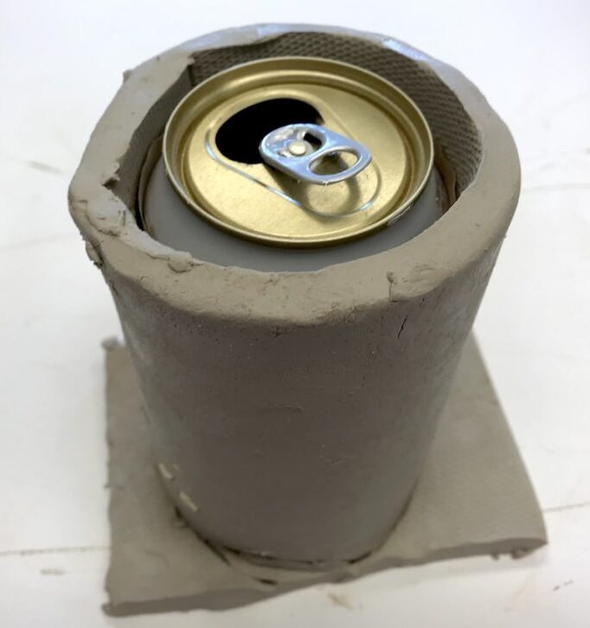
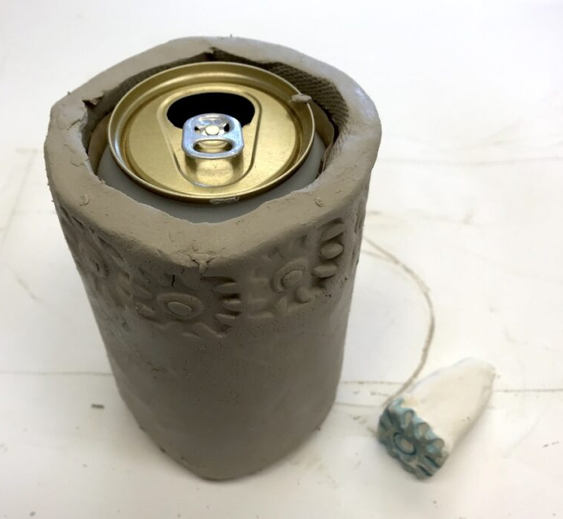
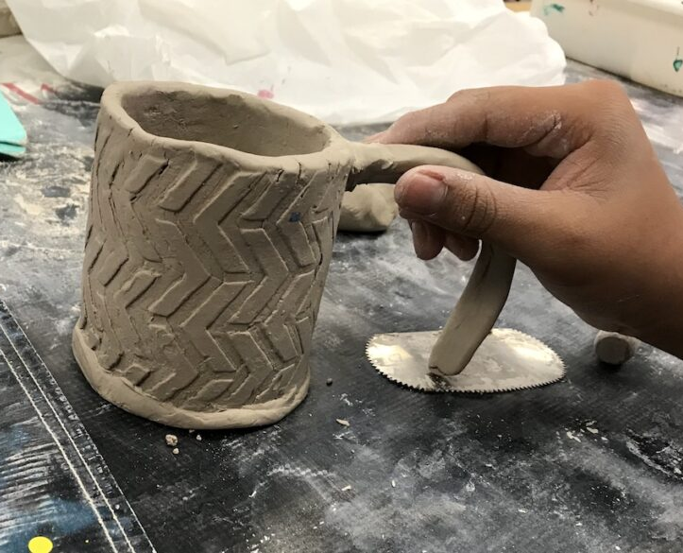
Slab Mugs - How To
Optional: You can also add a handle, if you prefer
Notes:
What purpose could this vessel have served?

Slide 42
Day 14 - Agenda
Gallery walk mid-project critique
Make sure to cover and spray down your work before you leave!

Slide 43
Gallery Walk Critique
Leave your work on your desk (make sure to spray it down well)
Grab a sheet of paper and write a question you would like your classmates to answer in relation to your project
Walk around, view all of your peers work
  Write answers to their questions, suggestions, or even ask your own questions

Slide 44
Day 15 - Agenda
Finish mug #1
  If your mug is dry, you can underglaze it today
Start working on mug #2
  ‘A gift for someone else’
Keep unfinished work covered and wet

Slide 45
Day 16 - Agenda
Finish mug #2
Glaze and underglaze mug #1

Slide 46
Day 17 - Agenda
Glaze or underglaze mug #1
Underglaze mug #2

Slide 47
Day 18 - Agenda
Glaze mug #2
  This is the last opportunity to glaze your projects before project #3
Response Assignment #4
  Due: Day 19 (next class)

Slide 48
Response Assignments
DUE: Day 19 (Next Class)
Choose an artist from the Artist List
  Explore their website and Google them
Write ~100 words in response to their ceramic works
  How does it make you feel? What do you like or dislike? What parts inspire you and your own work?
Include drawings

Slide 49
Artist List
Erin Jane Nelson
Claudia V. Solórzano
Nicki Green
Candice Lin
Morgan Rose Free
Sharif Farrag
Jessica Jackson Hutchins
Woody De Othello
Salvador Jiménez-Flores
Anders Herwald Ruhwald
Tammie Rubin
Wade Tullier
Kathy Butterly
Jane Margarette

Slide 50
Day 19 - Agenda
Receive mugs back
Partner up for TAG critique
Padlet critique

Slide 51
TAG Critique
Find a partner
Grab a sticky note and label it T: A: G:
  Write something you like, ask a question, give a suggestion
Continue until you’ve critiqued 3 of your peers

Slide 52
Padlet Critique
Take a good photo of your work
Upload to Padlet with a 75 word reflection of your work
  Meaningfully comment on at least 5 other peers work
  (cannot be one of your T.A.G. partners)
Example Padlet

Slide 53
Day 20 - Agenda
Introduce project #3 - Identity Vessels
Demo and teacher example
Research and rough sketches for project #3
  Due: Day 21

Slide 54
Identity Vessels
Research, references, and rough sketches
Two 3” prototypes
1 final vessel that represents a part (or whole) of your personal identity
  Min. size of 6”x8”

Slide 55
Identity
Our sense of who we are as individuals and as members of social groups
Our sense of how others may perceive and label us
Examples of identities: race, gender, economic class, age, ethnicity, nationality, language, ability, sexual orientation

Slide 56
What are some identities you are proud of?
Notes:
What have those experiences been like for you?

Slide 57
Project Timeline
Day 20
Day 21
Day 22
Day 23
Day 24
Days 25+26
Day 27
Days 28-31
Day 32
Day 33
Day 34
Day 35
Project Intro, Research, Sketches
Receive feedback + start prototypes
Finish 2 prototypes
Underglaze Protos, Response #5
Start final project
Work day
Small group crit, continue working
Final work days with wet clay
Underglaze Identity Vessels
Glaze Identity Vessels
Full class crit + self assessment
Continue crit

Slide 58
Project #3 - Research + Sketches
Find and research an artist (doesn’t have to be a ceramic artist) who shares an identity with you or art of your culture
  Find inspiration from this art
Sketch and write your plans and inspirations for project #3 in your sketchbook

Slide 59
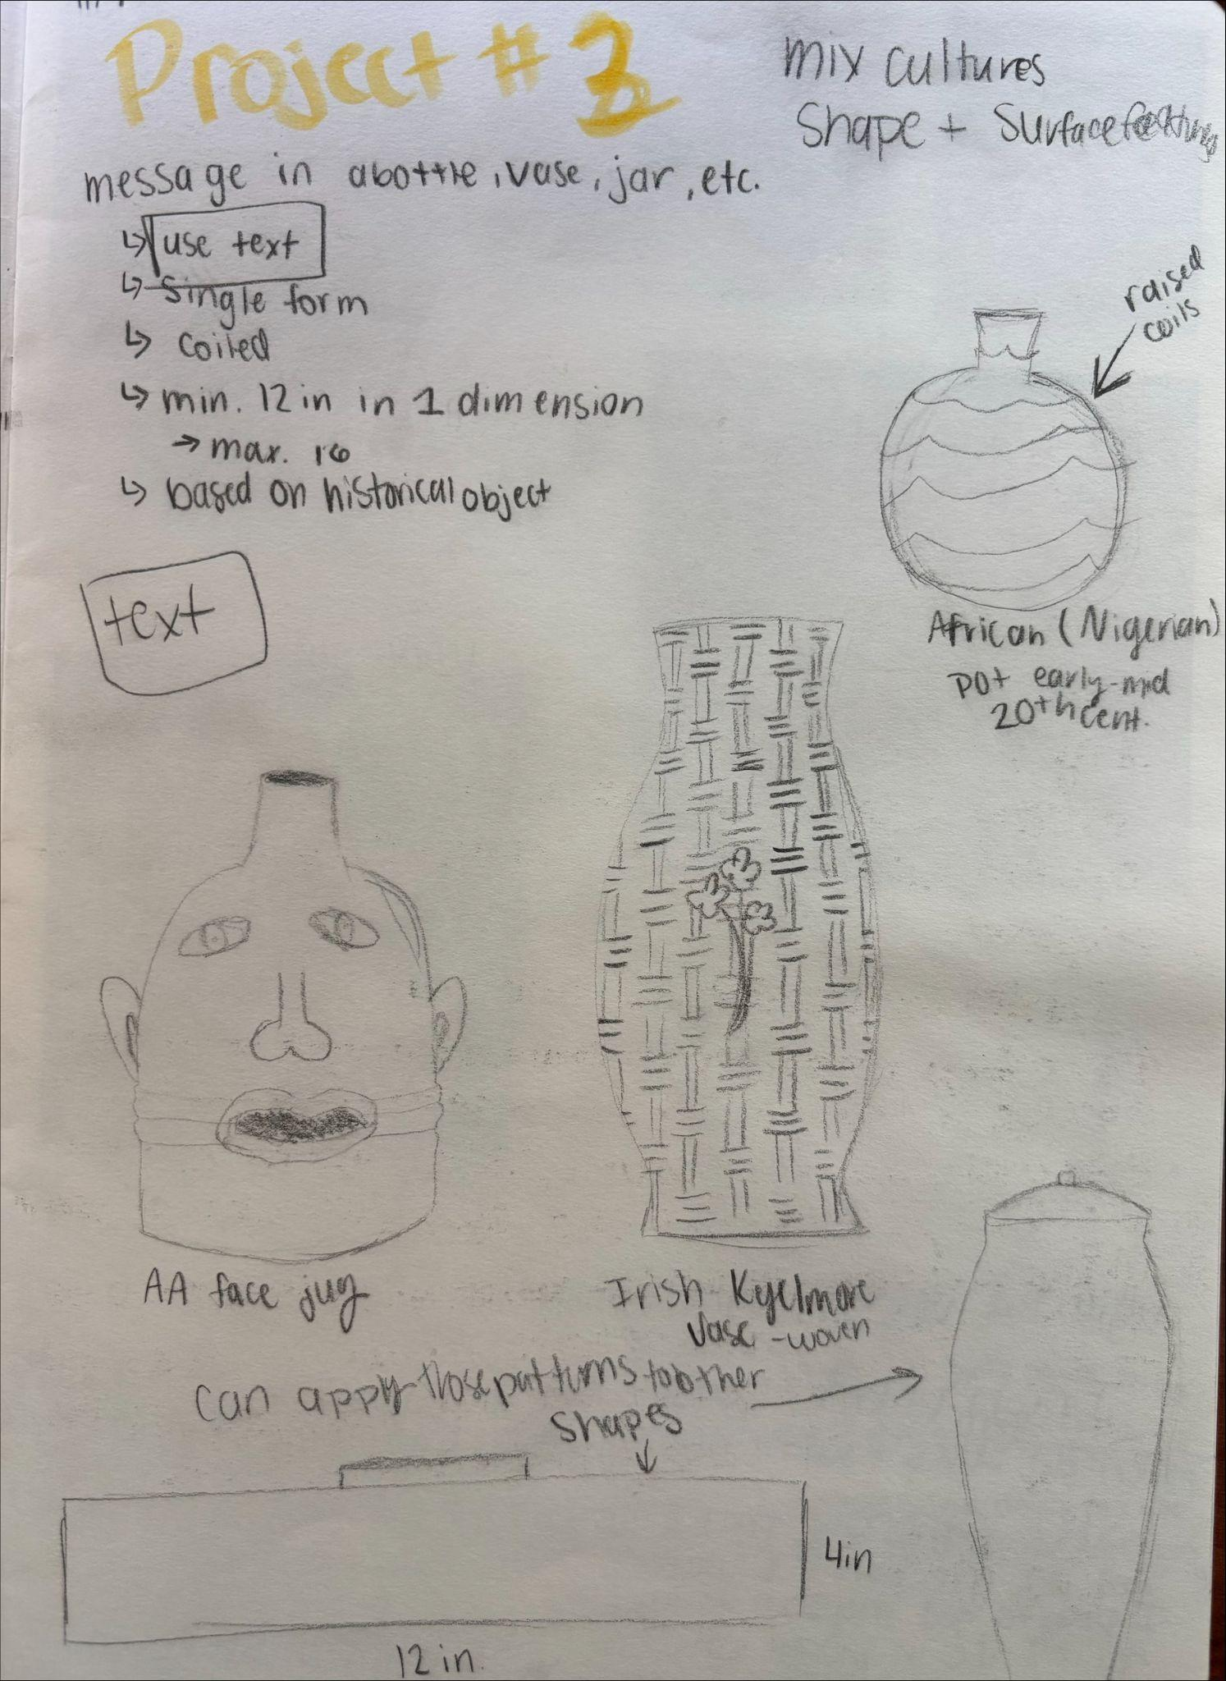
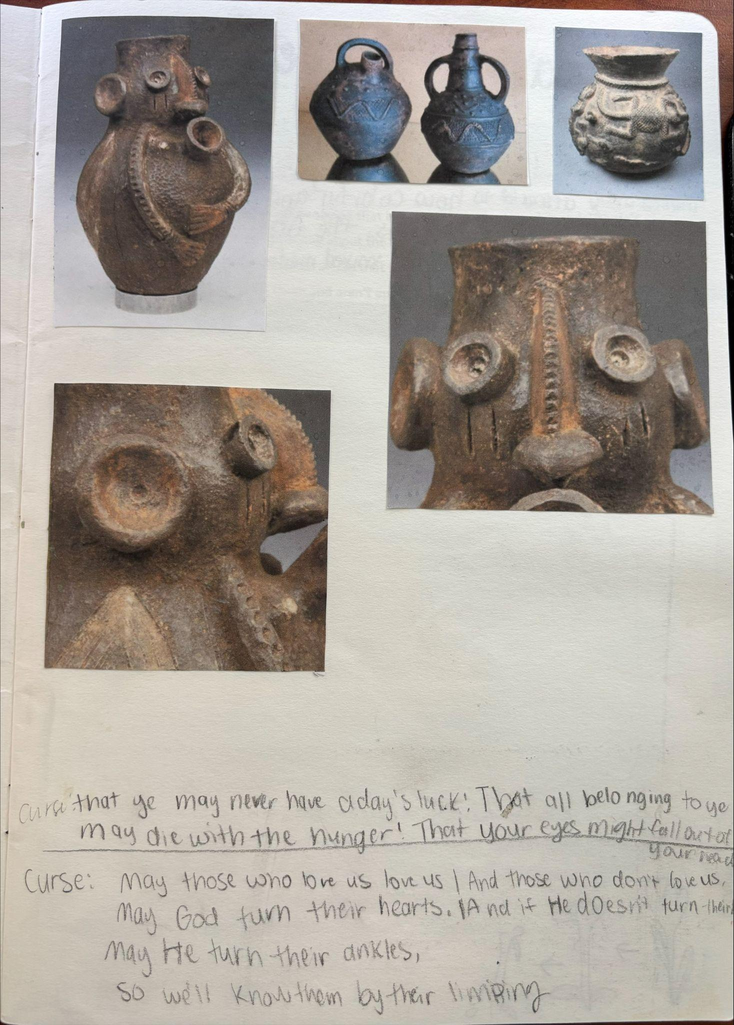
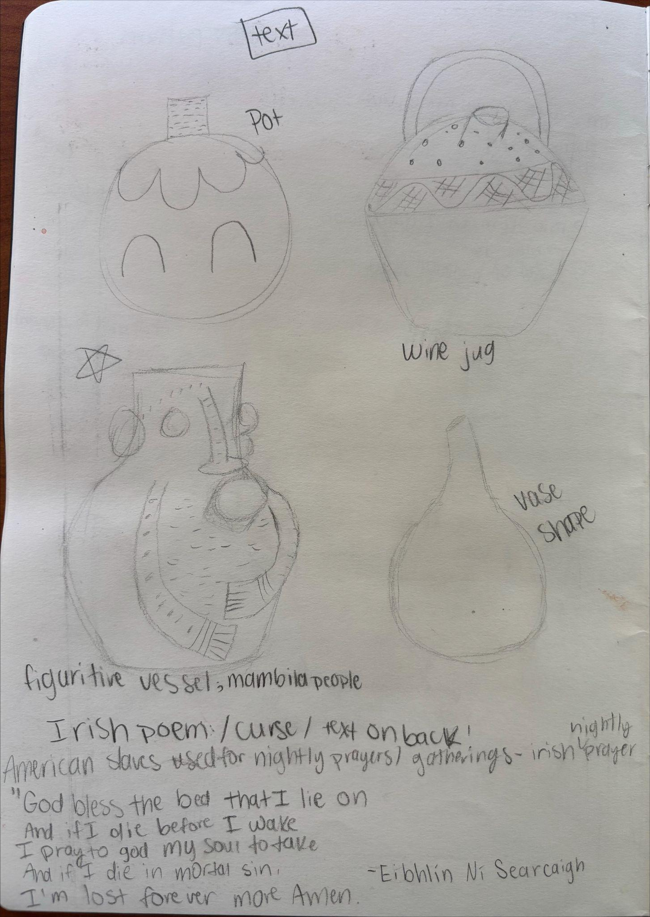

Slide 60
Day 21 - Agenda
Reflection and feedback on project plans
Get started on 2 prototypes/miniatures
  Must be 3” in at least one direction
OR
Revise your project plan

Slide 61
Day 22 - Agenda
Finish both prototypes
  Must be dry for next class

Slide 62
Day 23 - Agenda
Discuss how prototyping went in small groups
Optional: you may underglaze your prototypes
  Good opportunity to test colors and textures
If you have time, start your final project
Response Assignment #5
  Due: Day 26

Slide 63
Discussion Starters
Are you satisfied with your prototypes?
What are 2 things you will be changing?
Is there anything you won’t be changing from your prototypes?
Any suggestions for your group members?

Slide 64
Response Assignments
DUE: Day 26
Choose an artist from the Artist List
  Explore their website and Google them
Write ~100 words in response to their ceramic works
  How does it make you feel? What do you like or dislike? What parts inspire you and your own work?
Include drawings

Slide 65
Artist List
Erin Jane Nelson
Claudia V. Solórzano
Nicki Green
Candice Lin
Morgan Rose Free
Sharif Farrag
Jessica Jackson Hutchins
Woody De Othello
Salvador Jiménez-Flores
Anders Herwald Ruhwald
Tammie Rubin
Wade Tullier
Kathy Butterly
Jane Margarette

Slide 66
Day 24 - Agenda
Review project requirements and timeline
Everyone should be working on their final project today

Slide 67
Identity Vessels
1 final vessel that represents a part (or whole) of your personal identity
  Min. size of 6”x8”

Slide 68
Project Timeline
Day 20
Day 21
Day 22
Day 23
Day 24
Days 25+26
Day 27
Days 28-31
Day 32
Day 33
Day 34
Day 35
Project Intro, Research, Sketches
Receive feedback + start prototypes
Finish 2 prototypes
Underglaze Protos, Response #5
Start final project
Work day
Small group crit, continue working
Final work days with wet clay
Underglaze Identity Vessels
Glaze Identity Vessels
Full class crit + self assessment
Continue crit

Slide 69
Day 25 - Agenda
Work on your Identity Vessels

Slide 70
Day 26 - Agenda
Work on your Identity Vessels

Slide 71
Project Timeline
Day 20
Day 21
Day 22
Day 23
Day 24
Days 25+26
Day 27
Days 28-31
Day 32
Day 33
Day 34
Day 35
Project Intro, Research, Sketches
Receive feedback + start prototypes
Finish 2 prototypes
Underglaze Protos, Response #5
Start final project
Work day
Small group crit, continue working
Final work days with wet clay
Underglaze Identity Vessels
Glaze Identity Vessels
Full class crit + self assessment
Continue crit

Slide 72
Day 27 - Agenda
10 minute crit
  Get in groups of 3 or 4, discuss how the project is going so far
  Have your plans changed while making it?
Work on your Identity Vessels

Slide 73
Discussion Starters
Are you satisfied with your projects so far?
What are the things you like most about your progress? Why?
Is there anything you want to preserve?
Any suggestions for your group members?

Slide 74
Day 28 - Agenda
Work on your Identity Vessels
  Continue working on the smaller details

Slide 75
Day 29 - Agenda
Work on your Identity Vessels
  Finish up the main shape of your vessel and move onto smaller details today
Response #6
  Due: Day 31

Slide 76
Project Timeline
Day 20
Day 21
Day 22
Day 23
Day 24
Days 25+26
Day 27
Days 28-31
Day 32
Day 33
Day 34
Day 35
Project Intro, Research, Sketches
Receive feedback + start prototypes
Finish 2 prototypes
Underglaze Protos, Response #5
Start final project
Work day
Small group crit, continue working
Final work days with wet clay
Underglaze Identity Vessels
Glaze Identity Vessels
Full class crit + self assessment
Continue crit

Slide 77
Response Assignments
DUE: Day 31
Choose an artist from the Artist List
  Explore their website and Google them
Write ~100 words in response to their ceramic works
  How does it make you feel? What do you like or dislike? What parts inspire you and your own work?
Include drawings

Slide 78
Artist List
Erin Jane Nelson
Claudia V. Solórzano
Nicki Green
Candice Lin
Morgan Rose Free
Sharif Farrag
Jessica Jackson Hutchins
Woody De Othello
Salvador Jiménez-Flores
Anders Herwald Ruhwald
Tammie Rubin
Wade Tullier
Kathy Butterly
Jane Margarette

Slide 79
Day 30 - Agenda
Work on your Identity Vessels
  Finish up the smaller details
  Second to last day to work with it while it’s wet

Slide 80
Day 31 - Agenda
Finish working on your Identity Vessels
  Final day to work on it while it’s wet
  Leave your work uncovered to dry today

Slide 81
Project Timeline
Day 20
Day 21
Day 22
Day 23
Day 24
Days 25+26
Day 27
Days 28-31
Day 32
Day 33
Day 34
Day 35
Project Intro, Research, Sketches
Receive feedback + start prototypes
Finish 2 prototypes
Underglaze Protos, Response #5
Start final project
Work day
Small group crit, continue working
Final work days with wet clay
Underglaze Identity Vessels
Glaze Identity Vessels
Full class crit + self assessment
Continue crit

Slide 82
Day 32 - Agenda
Underglaze your Identity Vessels
Finish up any older projects, as needed

Slide 83
Day 33 - Agenda
Glaze your Identity Vessels
Finish up any older projects, as needed

Slide 84
Project Timeline
Day 20
Day 21
Day 22
Day 23
Day 24
Days 25+26
Day 27
Days 28-31
Day 32
Day 33
Day 34
Day 35
Project Intro, Research, Sketches
Receive feedback + start prototypes
Finish 2 prototypes
Underglaze Protos, Response #5
Start final project
Work day
Small group crit, continue working
Final work days with wet clay
Underglaze Identity Vessels
Glaze Identity Vessels
Full class crit + self assessment
Continue crit

Slide 85
Day 34 - Agenda
Get your Identity Vessels back
Whole class critique
Post-project self assessment
  Due: 11:59 pm Day 35

Slide 86
Whole Class Crit
Share a bit about your project and how it relates to your identity
  Only share what you are comfortable sharing
Be respectful of your peers when critiquing
Give meaningful feedback (no “I like” statements)
  WHY does something resonate (or not) with you?
  Ask Questions

Slide 87
Post-Project Self Assessment
Answer the following questions (in sketchbook or digitally):
  What concept or formal idea are you trying to communicate?
  What ceramic processes did you use to create this?
  What do you think are the strengths of this project? Why?
  What do you think the weaknesses of this project are? Why?
  If you created your work again, what would you change? Why?
  How were you challenged?
  What did you learn?

Slide 88
Day 35 - Agenda
Continue and finish critique
Take all of your work home with you today!

Slide 89
Whole Class Crit
Share a bit about your project and how it relates to your identity
  Only share what you are comfortable sharing
Be respectful of your peers when critiquing
Give meaningful feedback (no “I like” statements)
  WHY does something resonate (or not) with you?
  Ask Questions

